Slide 1
Understanding Medication Reconciliation
and Solving the “Med Wreck” Problem
Phil Smith, MD, MS, FAAFP
Friday, April 5, 2019

Slide 2
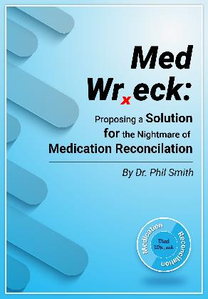

About the Speaker…
Author of the book, Med Wreck: Proposing a Solution for the Nightmare of Medication Reconciliation ©2017
Board-certified family physician with sub-specialty certification in clinical informatics
Physician, healthcare executive, consultant, author and mentor
Automated over 1% of hospitals in the U.S.
Author of Making Computerized Provider Order Entry Work, ©2012 Springer-Verlag, London
.
phil@MedMorph.com

Slide 3
Deconstructing Medication Reconciliation
Part 1: What is medication reconciliation and why do we care?

Slide 4
What is Med Rec?
- Essentially a process to create a complete, accurate and current list of medications as appropriate for the venue of care…
Med Rec is expected to occur whenever there is a “transition of care”.
It begins with first establishing the “List of Current Medications”
Here’s what I want to prescribe…
Here’s what meds I’m taking…
Plus:
What has been prescribed but:
Patient stopped
Not taking as directed
What the pharmacy thinks patient is taking…
What other doctors think the patient is taking…
What’s in my EHR…?
The Patient
Notes:
We currently have multiple data sources of what medications we think the patient is taking. It includes prescription medications, over-th-counter medications and supplements, and possible other medications or agents that may have been prescribed to others.
CLICK We may have a list from the patient, then a separate list in the patient’s medical record.
CLICK So the physician or prescriber reviews what the patient is on, what they’re taking, what needs to be stopped, and if any new medications need to be started.
CLICK Then we have to consider adherence.
Reconciliation is the process of examining each aspect of medication management and creating a new reconciled list of medications that will become the new medication list going forward.

Slide 5
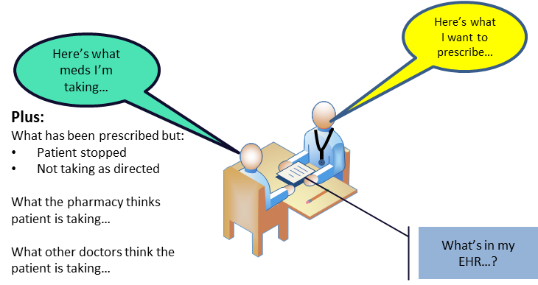
“Transitions of Care”
Represent hand-offs – patient home to office, home to ED, home to hospital, physician care to physician care, hospital to home health…
“Transitions of care” are associated with errors – mainly due to communication gaps between providers and information systems.
Notes:
Transitions of Care respresent some of the most dangerous parts of patient care. Information silos are frequent.

Slide 6
Why do we care?
Many Americans take one of more medications
Notes:
There are four major reasons why we should care about medication reconciliation being done correctly. The first is that medication use is growing in this country as our population ages and we see many more chronic diseases.

Slide 7
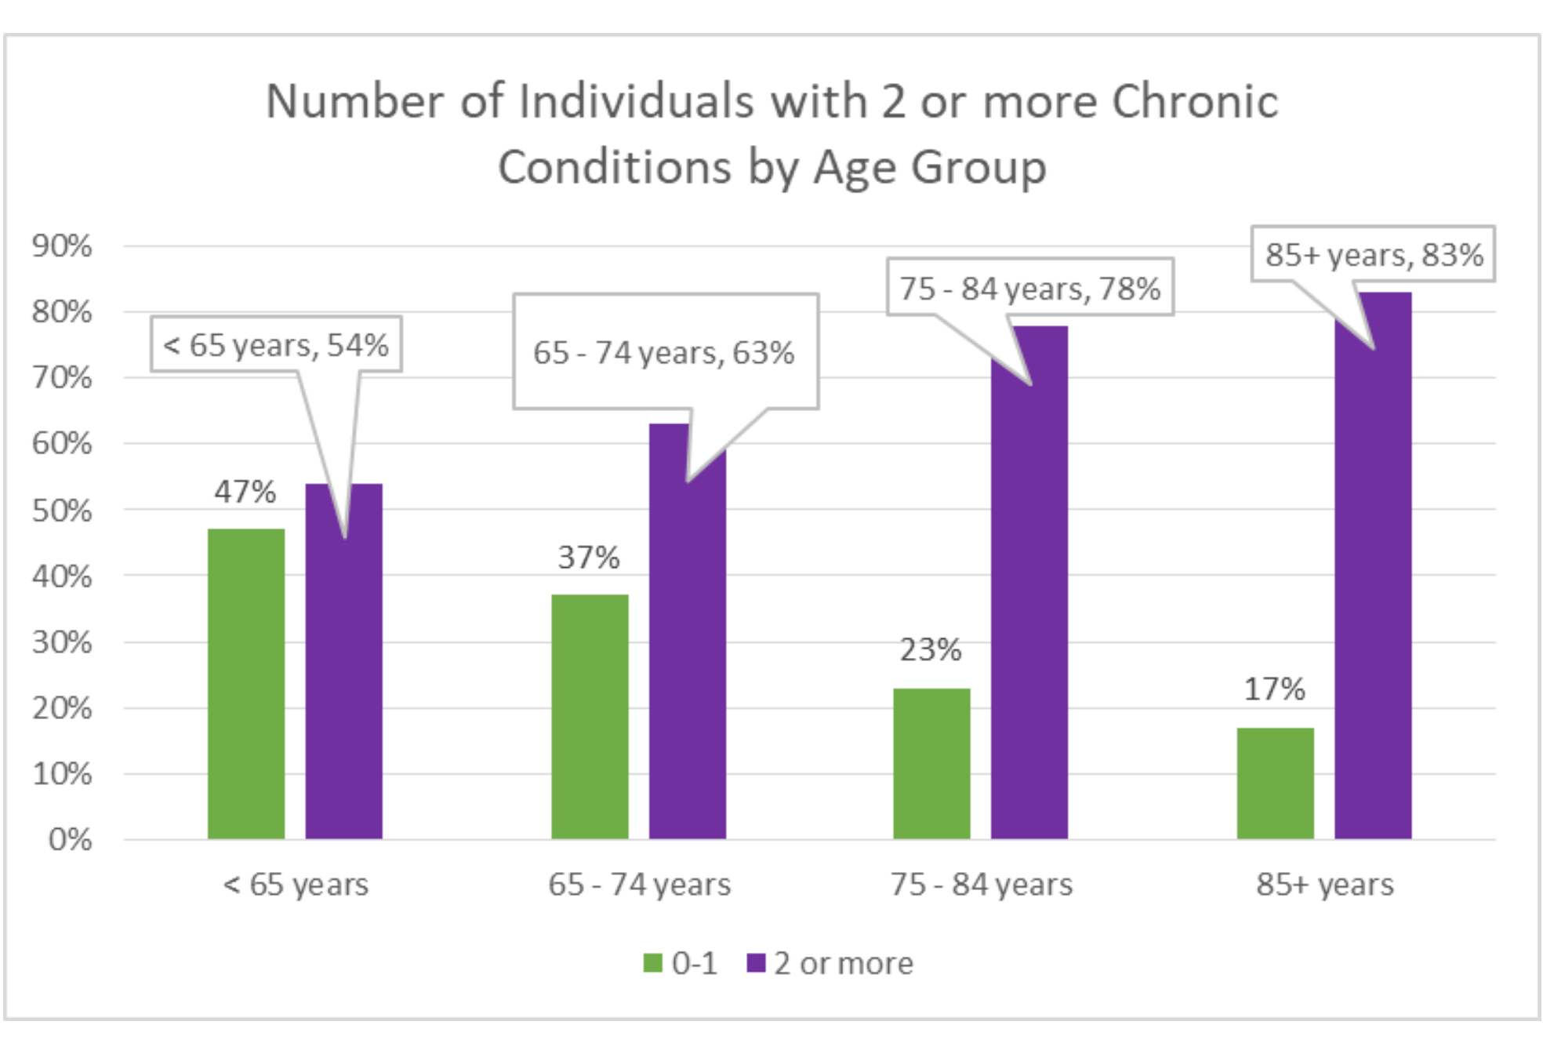
Some facts: about why so many meds are taken…
According to the CDC¹
“40% of Americans have one or more chronic conditions” and are likely taking one or more medications daily.
¹ National Center for Health Statistics, CDC.gov
Notes:
As our population is aging, we see more and more people with 2 or more chronic diseases.

Slide 8
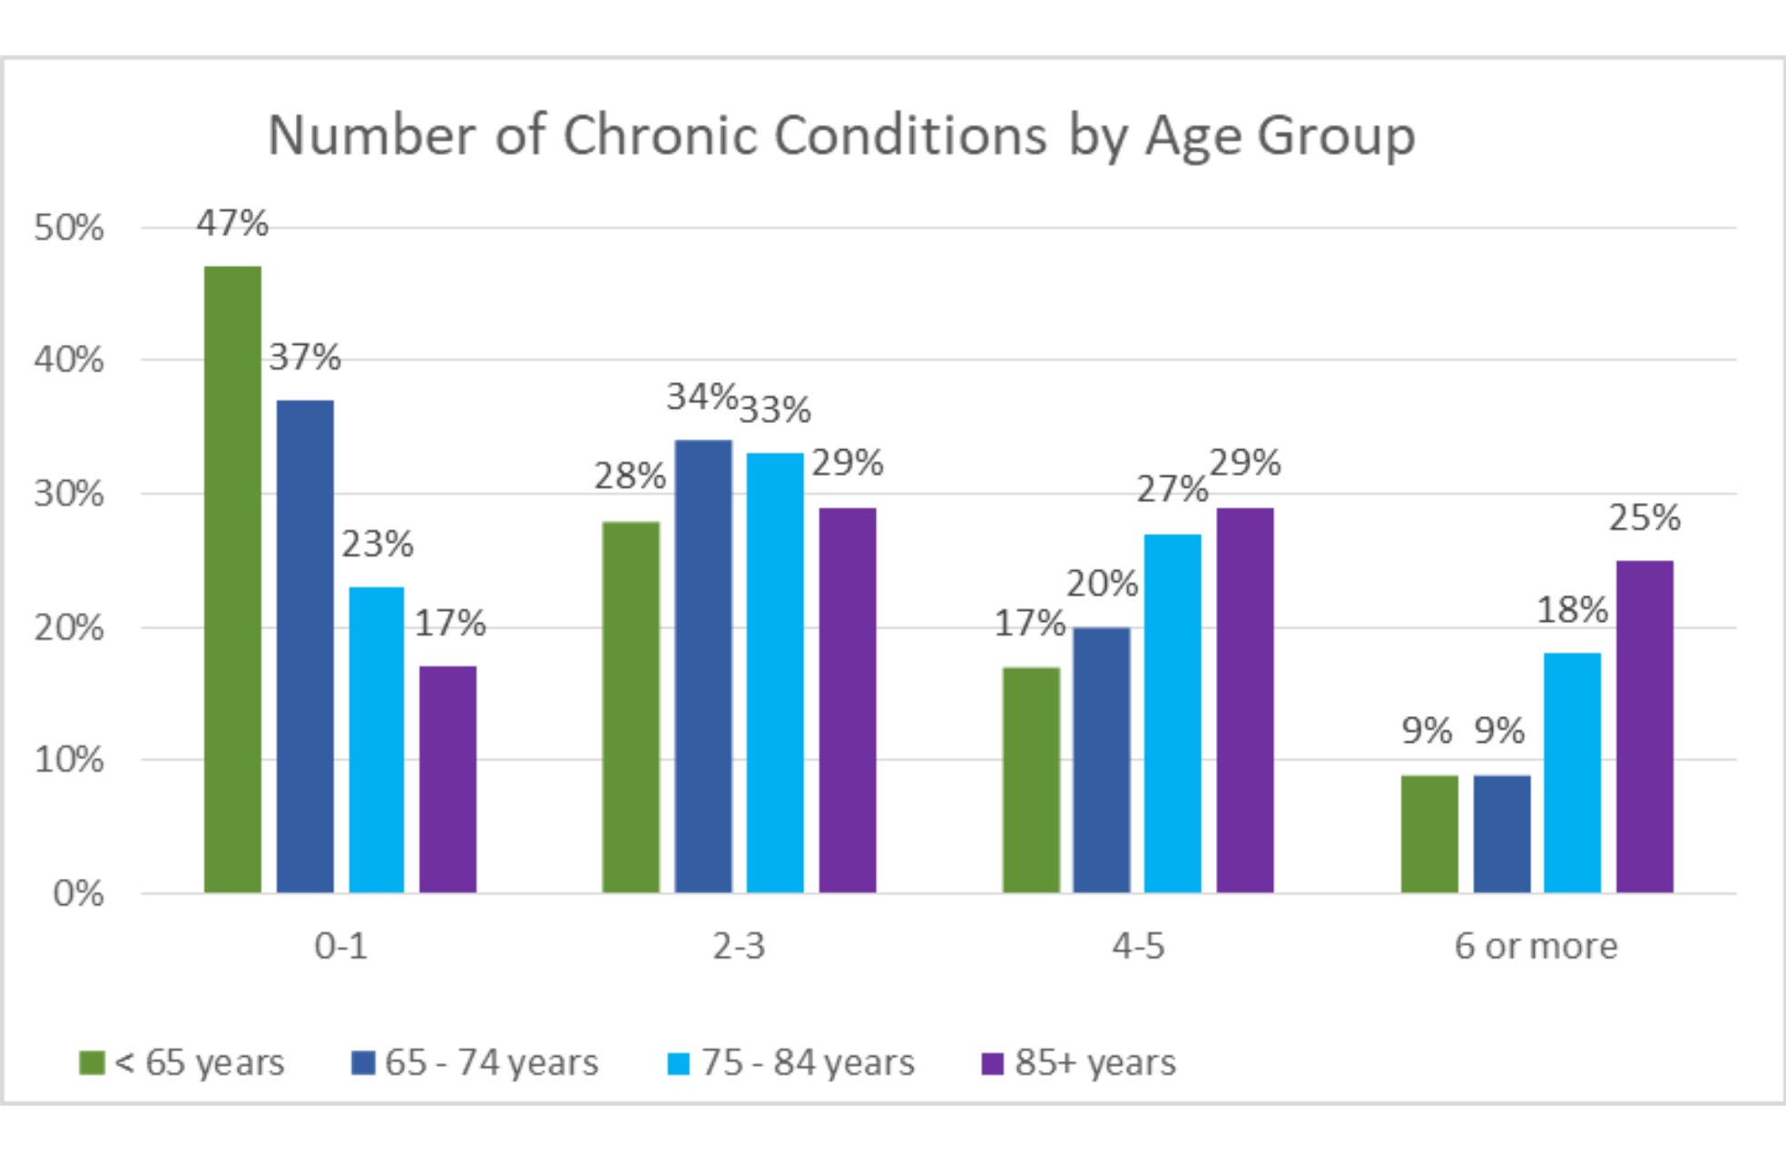
Some facts: about why so many meds are taken…
According to the CDC¹
“40% of Americans have one or more chronic conditions” and are likely taking one or more medications daily.
The number of chronic conditions increase with age.
¹ National Center for Health Statistics, CDC.gov
Notes:
And the number of chronic diseases increase with age with about a third of Medicare recipients living with 2-3 chronic illnesses.

Slide 9
Why do we care?
Many Americans take one of more medications
Medication errors do occur and for a variety of reasons.
Notes:
Medication errors do occur for a variety of reasons. And we spend a lot of clinical bandwidth each year just in trying to get it right.

Slide 10
Costs/Risks of current med rec
Have about 1.1 billion med reconciliation opportunities each year.
Consume at over 32,000 FTEs in physician, pharmacist and nurse resources each year.
Cost of over $3.8 billion/year.
Despite this effort, adverse drug events
Affect 2 million hospital stays annually
Prolong hospital stays by 1.7 – 4.6 days
Account for over 3.5 million physician office visits
Account for over 1 million ED visits
Estimated to account for 125,000 hospital admissions
Notes:
SLIDE As you can see, the cost of med rec is significant. With 32,000 FTEs from some of our most expensive resources in healthcare, doctors, pharmacists and nurses.
And despite the huge investment of their time, we still experience a large number of hospitalizations, emergency room and office visits solely related to preventable medication errors.

Slide 11
Some facts about medications…
According to the CDC¹
“40% of Americans have one or more chronic conditions” and are likely taking one or more medications daily.
The number of chronic conditions increase with age.
Adherence is an issue²
49% have forgotten to take a prescribed medication
31% had failed to fill a prescription
29% had stopped a medication prematurely.
¹ National Center for Health Statistics, CDC.gov
² ”Take as Directed: A Prescription Not Followed.”
National Community Pharmacists Association, December 2006
Notes:
And adherence remains an issue. It is often difficult to know what medication the patient is taking as well as the dose and instructions.

Slide 12
Medication errors can & do cause harm
Due to medications that are
Missed or inadvertently stopped (omission errors)
Administered wrongly (commission errors)
Overdosed (including duplicates)
Misused
In addition to allergic reactions, medication interactions and side effects.
Notes:
Adherence takes many forms as listed here [SLIDE]

Slide 13
Why do we care?
Many Americans take one of more medications
Medication errors do occur and for a variety of reasons.
To maximize the benefits and minimize the risks of each medication, it is important to have an accurate and complete list of precisely the medications to consider, both prescribed and over-the-counter (OTC) agents.
“Primum non nocere…”
Notes:
We want to know that we are maximizing the benefits of medication management while minimizing or avoiding unnecessary risks or harm. Thus the patient as well as the health care providers need to know what medications are currently being taken, whether those are prescribed, over the counter, or borrowed from a family member.
CLICK
Ultimately, it is summed up with the old dictum, [pri mon non no-kere] which is Latin for “First, do no harm…”

Slide 14
Deconstructing Medication Reconciliation
Part 2: The Mechanics of Med Rec

Slide 15
The Structure of the Med Order Prinivil 20 mg tab, PO daily
Medication (Trade and generic names)
Dose (or strength or volume. Includes a unit of measure)
Dosage Form (tab, cap, ER, CR, XR, liquid, sol., susp., inj.)
Route of Administration (PO, IM, IV, SQ)
Frequency (daily, twice a day, every 8 hours)
Special Instructions (custom comments)
+Prescriber, refills, pharmacy, start date, end date, duration.
Notes:
See handout on the Anatomy and Physiology of a Medication Order…

Slide 16
The mechanics of med rec…
Obtain a medication history
Done by staff, nurse, pharmacist and/or provider
Done from patient and/or caretaker/parent/guardian
Review against existing medication list (such as within the electronic health record (EHR))
Provider determines, for the new venue…
What to continue,
What to discontinue, and
What to add to the treatment plan
This creates a new, “reconciled” list of medications.
Discontinue
Add new med
Continue
NOTE: Formulary limitations also contribute to changes in the medication list.
Notes:
NOTE, that though we all think of the RED, YELLOW, GREEN of a traffic light, physicians may approach med rec decisions med by med, or by groupings such as What am I continuing, what am I stopping and what new meds am I adding. In the hospital this is complicated by formulary limitations. I’m showing this with color to reinforce that some systems use RED, YELLOW, GREEN, and arrange them in that order, even though physicians may approach he or her physician in a completely different order.

Slide 17
Notes:
Now, let’s work through med rec from a process flow perspective.

Slide 18
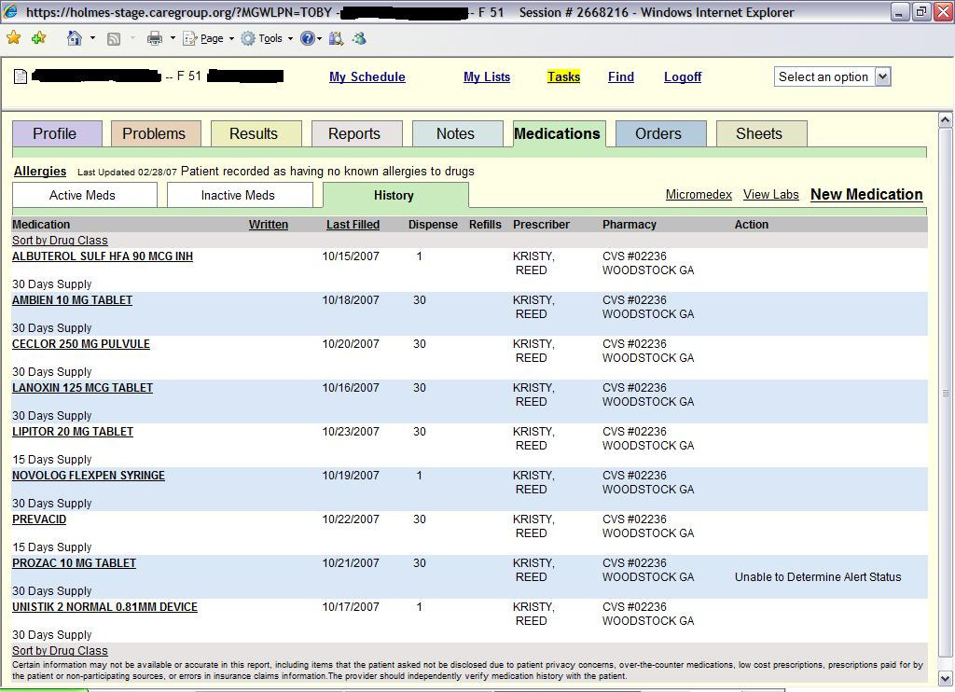
Typical EMR Medication History:
QHS = Take daily at bedtime. (a frequency)
PO = Take by mouth (a route)
Mg = milligrams (a dose strength)
Notes:
Medications histories can come from a variety of sources. This screen shot probably comes from a Pharmacy Benefits Manager or PBM. [CLICK] Notice we know what the med is, the dose, when it was started and by whom. We do not know the specific instructions on how and how often the patient should take each medication.

Slide 19
Typical EMR Medication Profile w/Med Rec:
+Add Med
Medication | Directions | Type | Refills | Ordered by | Continue | Stop | Rx (Start)
Lisinopril 40 mg Tab | PO, Daily | Rx | 3 | Phil Smith, MD
Baby Aspirin 82 mg Tab | PO, Daily | Hx | - | Outside Provider
Pravastatin 20 mg Tab | PO, QHS | Rx | 1 | Phil Smith, MD
*Meta Data may also be available on each med, like compliance (taking, not taking, not taking as prescribed) and last dose.
QHS = Take daily at bedtime. (a frequency)
PO = Take by mouth (a route)
Mg = milligrams (a dose strength)
Notes:
This shows how a medication reconciliation tool might create a way to document on the medication list which meds to continue or stop, or even an opportunity to start a new medication.

Slide 20
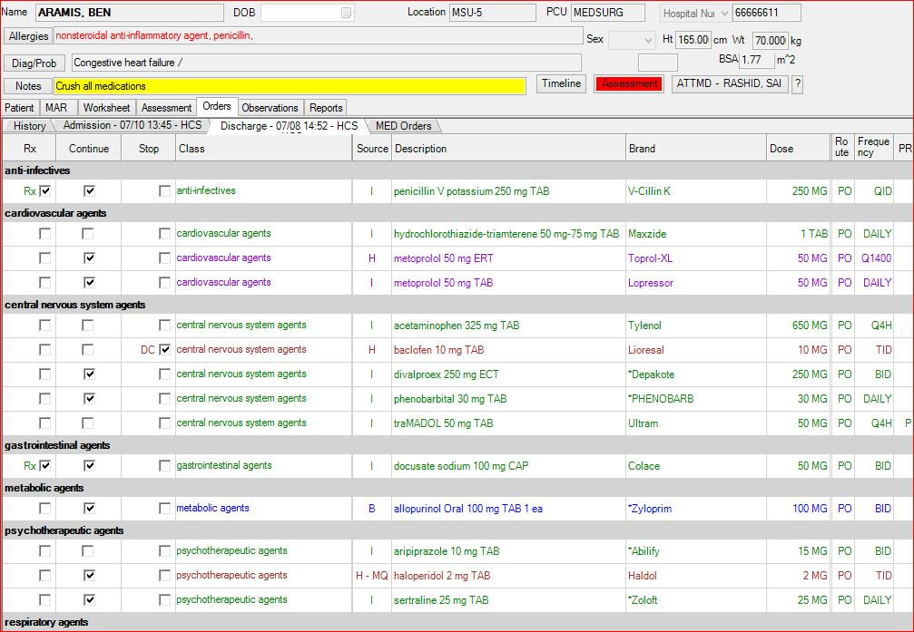
Typical EMR Med Rec Medication Tool:

Slide 21
Typical EMR Med Rec Medication Tool:
Medication | Directions | Type | Refills | Continue | Stop | Rx (Start) | Reconciled Med | Reconciled Directions
Lisinopril 40 mg Tab | PO, Daily | Rx | 3
Baby Aspirin 82 mg Tab | PO, Daily | Hx | -
Pravastatin 20 mg Tab | PO, QHS | Rx | 1
Notes:
You will see the current medications listed on the left. The provider then selects if each medication should be continued or stopped. In addition, new prescribed to outpatients or ordered will also show up on the right half of the list.

Slide 22
Deconstructing Medication Reconciliation
Part 2: Garbage in; garbage out. Why is this so hard?

Slide 23
What could possibly go wrong?
There are >30 common failure points in obtaining a true and accurate list of medications
Patient factors
Disease/Condition factors
Physician/Provider factors
Medication and Pharmacy factors
Socio-Economic factors.
Notes:
The foundation of medication reconciliation is that we first must ascertain what is the true and accurate current list of medications.

Slide 24
Patient Factors

Slide 25
8 Patient Factors
Culture & Beliefs
Accessibility to Care
Cognitive Abilities
Education
Healthcare literacy
Adherence to Prescribed Medications
Transparency of compliance
Dosing & Administration understanding

Slide 26
Disease and/or Condition(s) Factors

Slide 27
5 Disease &/or Condition(s) Factors
Co-Morbidities
Cardiovascular conditions
Diabetes
Kidney or Liver dysfunction
Genetic traits

Slide 28
Disease and/or Condition(s) Factors

Slide 29
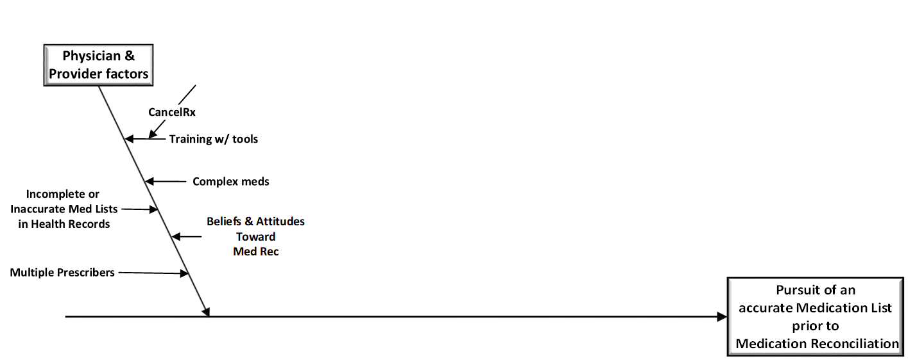
6 Physician / Provider Factors
Incomplete or Inaccurate Med Lists in Health Records
Multiple Prescribers
Training with tools
CancelRx
Complex meds
Beliefs & Attitudes toward Med Rec

Slide 30
Disease and/or Condition(s) Factors

Slide 31
6 Medication & Pharmacy Factors
Drug-Drug interactions
Drug-Food interactions
Drug-Allery interactions
Trade vs. Generic names
Therapeutic duplicates
“Sound-alikes”
Multiple pharmacies
“Side Effects” in Allergy Tables

Slide 32
Socio-Economic Factors

Slide 33
Socio-Economic Factors
Costs
Formularies
Accessibility to pharmacies and medical education
Disposable Income
Pharmacy Coverage
Living Situation

Slide 34
Med Rec itself is a “broken process”
Mainly because there are too many sources of medication lists that have to be reconciled.
If we could create one, continuously updated list of medications, and everyone used it, from patient, caregiver, pharmacy, physicians and anyone else in the loop, we could eliminate much of the confusion.
This is called, “Creating a Single Source of Truth”

Slide 35
A Single Source of Truth (SSOT)
Maintaining a SSOT for medication histories and then providing it in the EHR workflow as a service, perhaps from a state-wide HIE, could eliminate the Medication History silos in each medical record.
Would most likely require a public-private partnership with buy- in by Americans that they would allow some considerations for privacy and security risks over the risks of harm from the current system.

Slide 36
The Challenge before us…
Obtain a clean, accurate and up-to-date list of current medications that
Reflects not only what has been prescribed, but what the patient is actually taken.
Place it in the clinical workflow
Allow reconciliation to occur at multiple transitions of care
Create seamless updates for ongoing medication management

Slide 37
Questions or Comments?
Free eBook at www.MedWreckFreedom.com
phil@MedMorph.com

